Slide 1

Deloitte Pre Hire Training 2017
FOUNDATION TRAINING
Spring MVC

Slide 2
Spring 3 MVC
Interceptors

Slide 3
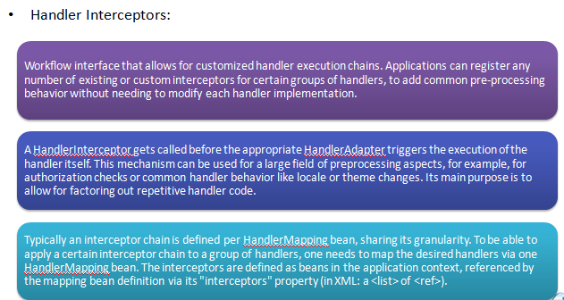
Handler Interceptors

Slide 4
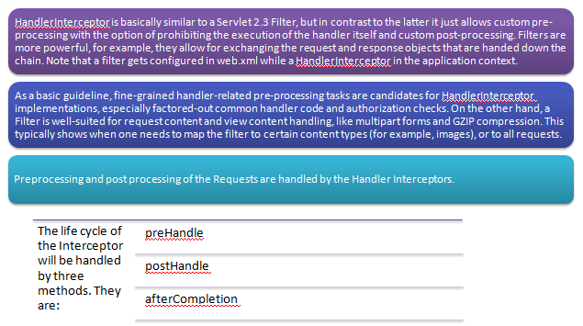
Handler Interceptors

Slide 5
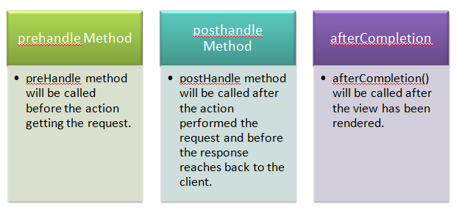
Interceptors Life Cycle Methods

Slide 6
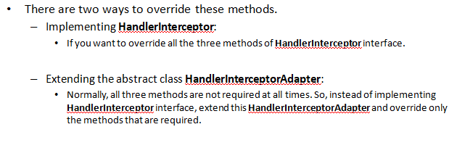
Overriding the Methods

Slide 7
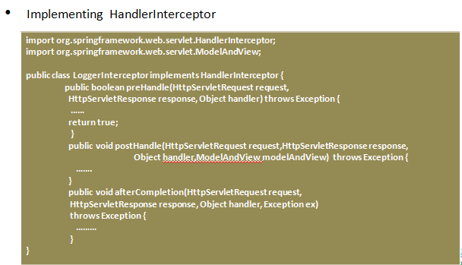
Implementing HandlerInterceptor

Slide 8
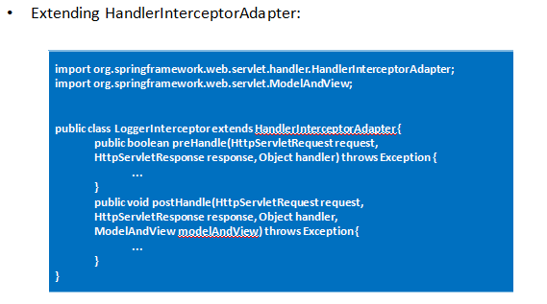
Extending HandlerInterceptonAdapter

Slide 9
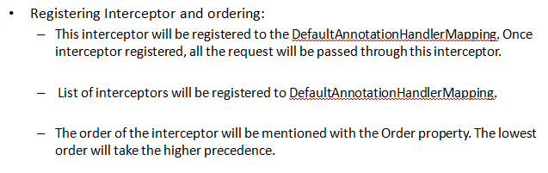
Registering Interceptors and Ordering

Slide 10
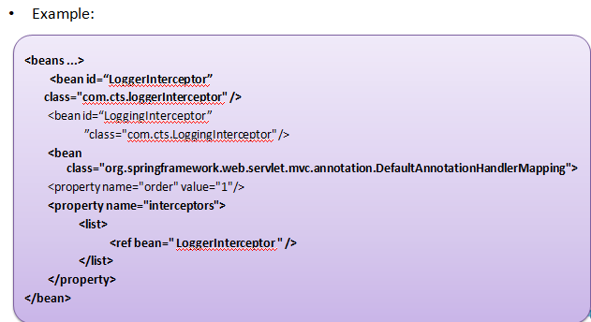
Registering Interceptors and Ordering

Slide 11
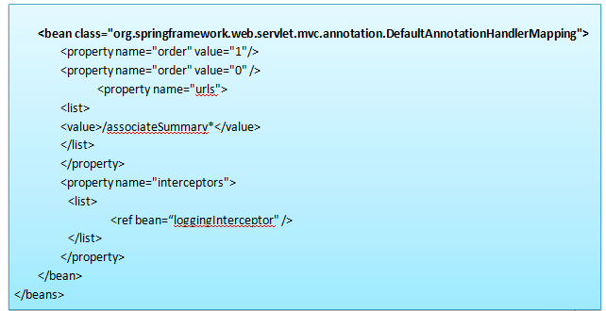
Registering Interceptors and Ordering

Slide 12
Demo
Sample code to explain Interceptors

